Slide 1





Synopsis Presentation
on
AI- Mock Interview with Streaming Avatar”
Synopsis Presentation
on
“CarbonLens – AI-Powered Carbon Footprint Tracker”
Pranav Singh (0827IT231100)
Sachin Kushwaha (0827IT231113)
Sanskar Rathore (0827IT231118)
Sejal Jain (0827IT231123))
Guided By: Presented By:
Prof.(Dr)Brajesh Chaturvedi
External Guide:
Mr. Aniket Jhawar

Slide 2

Contents
Introduction
1.1 Overview
1.2 Purpose
Literature Review
Problem Statement
Proposed Solution
Objectives
Theoretical Analysis
5.1Block Diagram
5.2Hardware Requirements
5.3Software Requirements
Applications
GitHub Link
References
2

Slide 3
1. Introduction
1.1Overview
CarbonLens is an AI-powered web application designed to help users track and understand their personal carbon footprint. It enables users to record daily activities related to transportation, energy consumption, diet, and other lifestyle choices, and estimates the carbon emissions generated from these activities.
The system uses artificial intelligence to analyze user data and provide personalized sustainability tips and recommendations. Interactive dashboards and reports help users visualize emission trends, identify major sources of emissions, and monitor their progress over time. By combining AI with an easy-to-use interface, CarbonLens encourages individuals to adopt environmentally responsible habits and contribute towards a more sustainable future.
CarbonLens also supports AI-assisted activity analysis, allowing users to describe their activities in natural language for automatic emission estimation. The platform promotes awareness and motivates users to make small lifestyle changes that can collectively create a positive environmental impact.
1.2 Purpose
The purpose of CarbonLens is to help individuals become more aware of the environmental impact of their daily activities by providing an easy and effective way to monitor carbon emissions. The platform encourages users to adopt sustainable habits by tracking emissions from different lifestyle choices and presenting them in a simple, understandable format.
It also aims to provide personalized recommendations through AI-generated insights, helping users identify areas where they can reduce their carbon footprint. Through interactive dashboards, reports, and continuous feedback, CarbonLens motivates users to make informed decisions and contribute towards building a greener and more sustainable future.
3

Slide 4
2. Literature Review
S.No | Author | Features | Methods | Advantages | Disadvantage
1 | Carbon Footprint Monitoring Studies | Emission tracking | Activity-based calculations | Environmental awareness | Limited personalization
2 | AI Recommendation Systems | AI Recommendation Systems | AI Recommendation Systems | AI Recommendation Systems | AI Recommendation Systems
3 | Sustainable Lifestyle Platforms | Sustainable Lifestyle Platforms | Sustainable Lifestyle Platforms | Sustainable Lifestyle Platforms | Sustainable Lifestyle Platforms
4 | Emission Analytics Systems | Emission Analytics Systems | Emission Analytics Systems | Emission Analytics Systems | Emission Analytics Systems
5 | AI-driven Sustainability Applications | AI-driven Sustainability Applications | AI-driven Sustainability Applications | AI-driven Sustainability Applications | AI-driven Sustainability Applications
4

Slide 5
3. Problem Statement
Many individuals are unaware of how their daily activities contribute to carbon emissions and environmental degradation.
Existing carbon footprint calculators often provide only one-time estimates and lack continuous tracking features.
Most available platforms do not offer personalized recommendations to help users reduce their carbon footprint effectively.
Users face difficulties in identifying which activities contribute the most to their overall emissions.
There is a lack of interactive dashboards and detailed reports that can help users monitor their progress over time.
Therefore, there is a need for an AI-powered system that can track carbon emissions, provide meaningful insights, and encourage sustainable lifestyle choices through personalized guidance and real-time analytics
5

Slide 6
4.Proposed Solution
CarbonLens provides a user-friendly platform where users can record their daily activities related to transportation, energy usage, diet, and other lifestyle choices.
The system automatically estimates the carbon emissions generated from these activities and categorizes them into different emission sources for better understanding.
An AI-powered assistant analyzes user inputs and generates personalized sustainability tips and recommendations to help reduce carbon footprints.
Interactive dashboards and visualizations display real-time metrics, weekly trends, carbon scores, and category-wise emission breakdowns.
Weekly and monthly reports allow users to monitor their progress, identify improvement areas, and track changes in their emission patterns over time.
By combining artificial intelligence, data analytics, and an intuitive interface, CarbonLens encourages users to adopt environmentally responsible habits and contribute towards a more sustainable future.
7

Slide 7
5. Objectives
To develop an AI-powered platform for tracking and monitoring personal carbon emissions.
To calculate and categorize carbon emissions generated from daily activities such as transportation, energy consumption, and diet.
To provide personalized sustainability tips and recommendations using artificial intelligence.
To visualize emission data through interactive dashboards, charts, and carbon scores for better understanding.
To generate weekly and monthly reports that help users analyze their progress and identify areas for improvement.
To encourage individuals to adopt environmentally responsible habits and contribute towards a greener and more sustainable future.
7

Slide 8
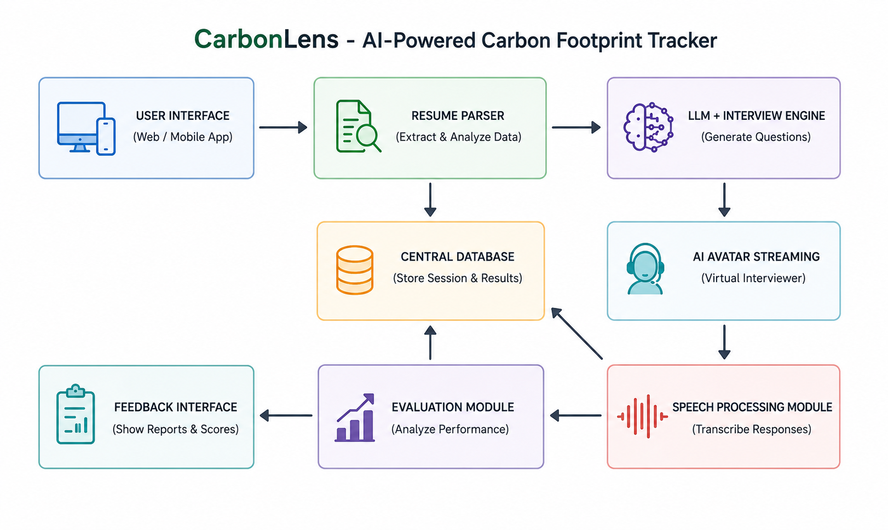
6. Theoretical Analysis
6.1 Block Diagram
fig. 1. Architecture of AI Mock Interview with Streaming Avatar
8

Slide 9
6. Theoretical Analysis
6.2 Hardware Requirements:
Since this is a software-focused project, hardware needs are minimal:
Processor: Intel Core i3/i5 or equivalent multi-core processor.
RAM & Storage: Minimum 8 GB RAM with 256 GB HDD/SSD.
Internet Connectivity: Stable internet connection for accessing the application and Ollama AI services.
6.3 Software Requirements
Component | Technology Used
Programming Language | JavaScript
Frontend | React 18, Vite, Tailwind CSS
Backend | Node.js and Express.js
Database | MongoDB with Mongoose
AI Integration | Ollama (Llama2/Mistral)
Development Tools | VS Code, Git, and GitHub
9

Slide 10
Applications
Personal Carbon Footprint Tracking: Helps individuals monitor and manage their daily carbon emissions.
Sustainability Awareness: Encourages users to adopt eco-friendly habits through AI-generated recommendations.
Educational Institutions: Can be used to educate students about climate change and environmental responsibility.
Corporate Sustainability Programs: Assists organizations in promoting sustainable practices among employees.
Environmental Research: Provides emission data and trends useful for analysis and decision-making.
Progress Monitoring: Enables users to track improvements in their carbon footprint over time through reports and dashboards.
10

Slide 11
GitHub Link
https://github.com/Sejaljain208/Carbon-footprint-tracker
11

Slide 12
REFERENCES
Ollama Documentation – Local LLM Integration for Carbon Emission Analysis and Personalized Recommendations.
React 18 Documentation – Development of Interactive and Responsive User Interfaces.
Node.js and Express.js Documentation – Backend Server and RESTful API Implementation.
MongoDB and Mongoose Documentation – Database Management and Data Modeling.
Tailwind CSS Documentation – Responsive and Utility-First User Interface Design.
JSON Web Token (JWT) Documentation – Secure User Authentication and Authorization.
12

Slide 13
Thank You
We are open to suggestions now..
13

